Slide 1
Developing an 8-Bit Atari game Created by Yaron Nir (yaronnir2006@gmail.com)

Slide 2
Starting questions
How many developers
Leading languages
Game developers

Slide 3
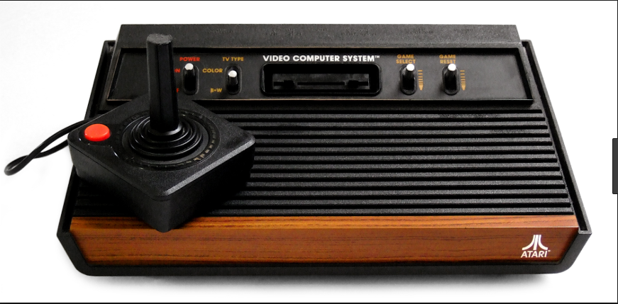
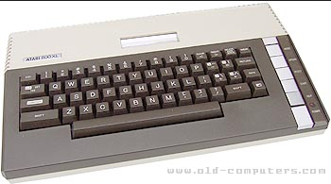
About myself
44 , married + 2 children
Teva Pharmaceutical, Technical owner , Digital Health Platform
ooVoo startup company, 13 year, last role VP R&D

Slide 4
Back in the 80s
Either Basic or Assembly (needed special cartridge)
Monthly magazines
Small collection of books
No strong debugger
No development IDE
No sound tools
No stack overflow
No internet examples
No social media
No YouTube lessons
NOTHING!

Slide 5
What do we have now?
High languages (C, Action!, Pascal, Turbo Basic and more)
Strong assembly compilers
Strong tools to create levels, characters, sprites, splash screens and much more
PC emulators such as Altirra, AtariWinPlus
Sound utilities such as RTM128
Online reference
Strong leading forums such as Atari Age
YouTube tutorials
Social Media

Slide 6
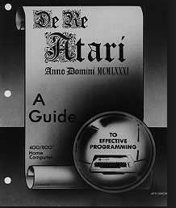
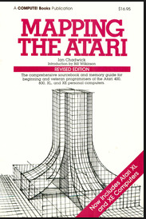
Learn The Atari Inside Out

Slide 7
Atari 8 Bit Internals
Main processor – 6502 instructions
Graphics chips – ANTIC/GTIA
POKEY chip – sound and I/O
ANTIC Display List
Graphics modes
Multi-color screens
Hi-Res
Screen Scrolling – Fine Scrolling
Hardware Sprites – 4 players, 4 missiles (5th player)
Software Sprites
Custom characters
Joystick controllers
Sound

Slide 8
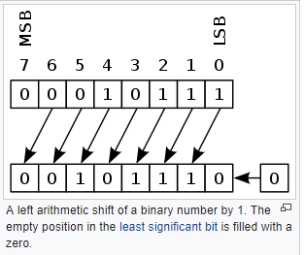
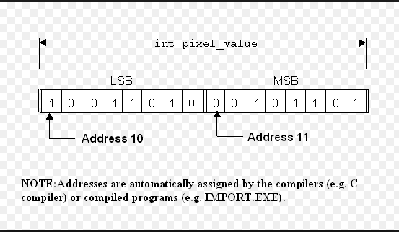
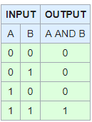
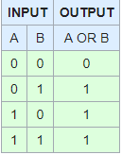
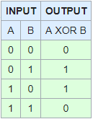
Arithmetic and Bitwise
Bit Shifting
Peek & Poke
And/Or/XOR

Slide 9
Shifting bits
8 bits
11000000
Shifts right == divide:
>>1 (divided by 2)
01100000
>>2 (divided by 4)
00110000
>>3 (divided by 8)
00011000
>>4 (divided by 16)
00001100
>>5 (divided by 32)
00000110
>>6 (divided by 64)
00000011

Slide 10
Shifting bits
8 bits
00000011
Shifts left == multiply:
<<1 (multiply by 2)
00000110
<<2 (multiply by 4)
00001100
<<3 (multiply by 8)
00011000
<<4 (multiply by 16)
00110000
<<5 (multiply by 32)
01100000
<<6 (multiply by 64)
11000000

Slide 11
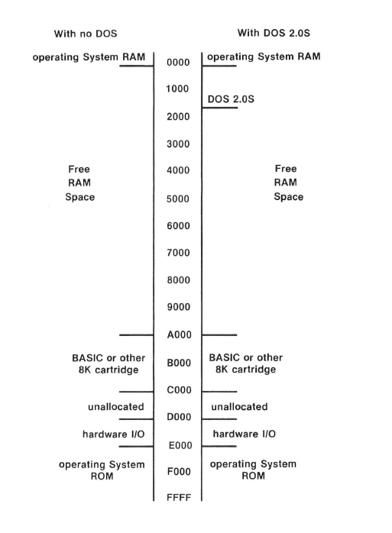
Atari Memory Layout

Slide 12
Atari Memory
$00-$FF - zero page for the operating system (don’t use)
$80-$FF - zero page to be used in your program
$100-1FF - CPU stack
$200-$2FF – OS vectors , registers (for example color registers)
$300-$3FF – OS vectors, registers
$400-$5FF – OS buffers (used for example for converting operations)
$600-$6FF – Page 6. used for object code in basic programs (don’t use)
$700 - $1FFF – Disk operating system (don’t use)
$2000-RAMTOP – our code
$8000-$9FFF – used for cartridge (8K cart / part of 16K cart)
$A000-$BFFF – used for cart (8K cart / high part of 16K cart)
$C000 - $CFFF – operating system part 1
$CC00 - $CFFF – operating system international character set
$D800 - $DFFF – FPP –(Floating point package for operating system floating point operations)
$E000 - $FFFF – operating system part 2
$E000-$E3FF – operating system default character set

Slide 13
Chip Memory Map
Each chip map holds 1 page (256 bytes) but not all of the page is used
$D000-$D0FF – GTIA chip (television interface adapter, provides pixels, colors, sprites/player missiles, console input keys, beep)
$D100- $D1FF – PBI (parallel ports, external chips that are not built in)
$D200 – $D2FF - POKEY (paddle, keyboard, serial IO and Audio)
$D300 - $D3FF – PIA (joystick, MMU memory layout, for example switching off basic or OS)
$D400 - $D4FF – ANTIC (DMA to feed GTIA with data)
$D500 - $D5FF – Module Port (R/W)
$D600-$D7FF – Reserved (for built in extensions such as VBXE(

Slide 14
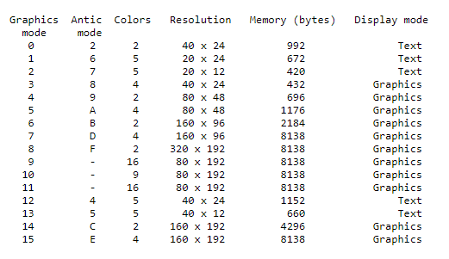
Atari Graphics

Slide 15
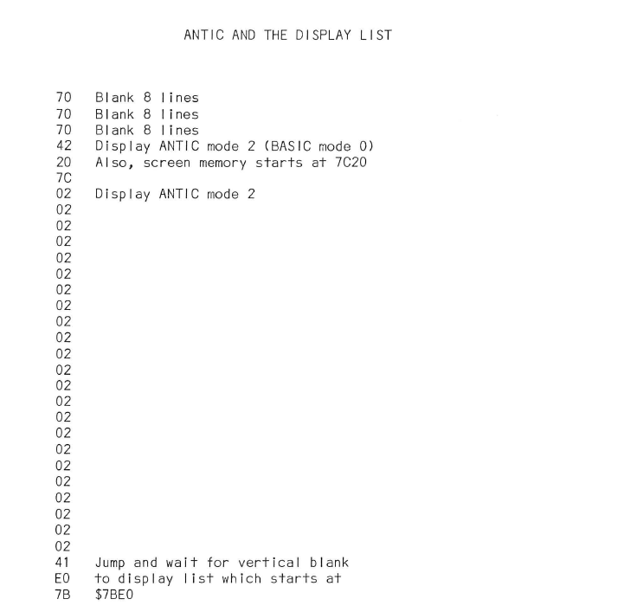
Display List

Slide 16
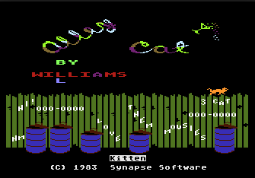

Slide 17
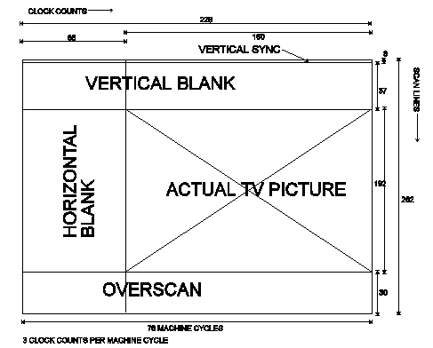
Display List Interrupt - DLI

Slide 18
VBLANK
Interrupt that occurs every 60th of a second/50th of a second NTSC/PAL respectively
You can’t disable it, system keeps calling it every time
Occurs when screen has been blanked, changes made during the interrupt will not be immediately seen on the display – a powerful advantage.
Registers A,X,Y content are placed on stack
System loops the vblank vectors

Slide 19
Immediate and deferred VBLANK
System starts with vvblki – the immediate vblank vector ($0222), this vector points to $E45F address, to understand where the OS default routine is located. OS Default routine includes the following operations:
Increment the real time clocks (12,13,14 addresses)
Color attracting (screen protected mode)
Copy shadow registers
Update values from the input controller
System then iterates to the vvblkd – the deferred vertical blank vector ($0224) , that vectors points on a simple interrupt termination at $E462
At the end of the vblank routine you must push back the registers A,X,Y values from the stack

Slide 20
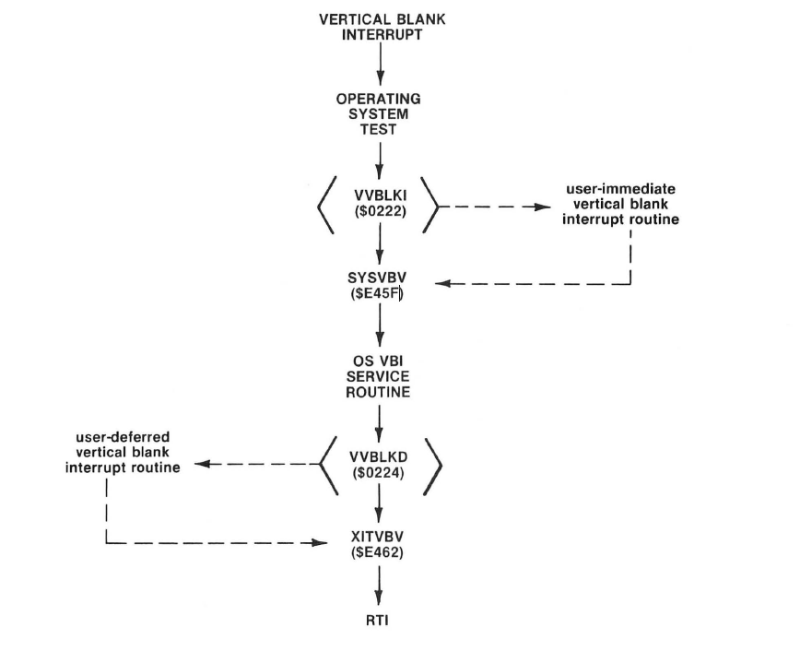
VBLANK flow

Slide 21
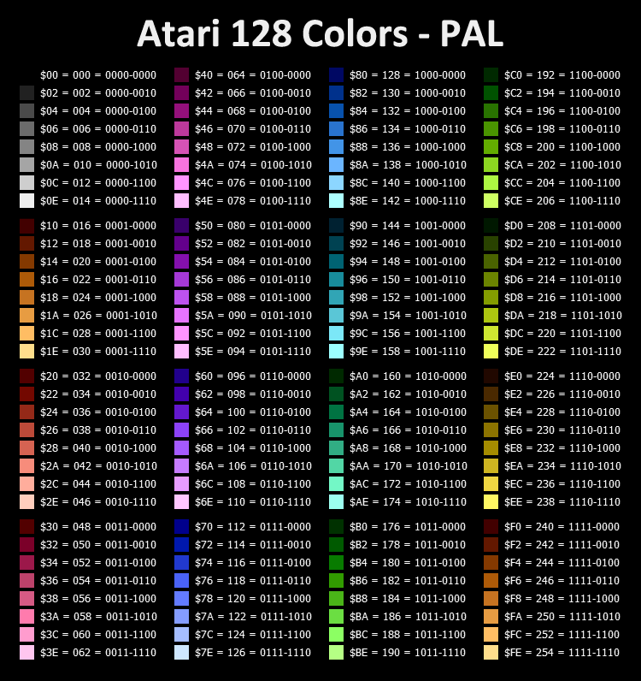
Atari Color Pallate

Slide 22
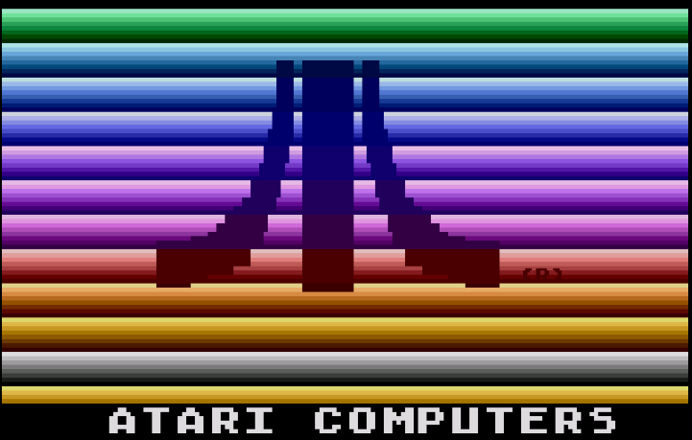

Slide 23
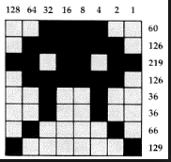
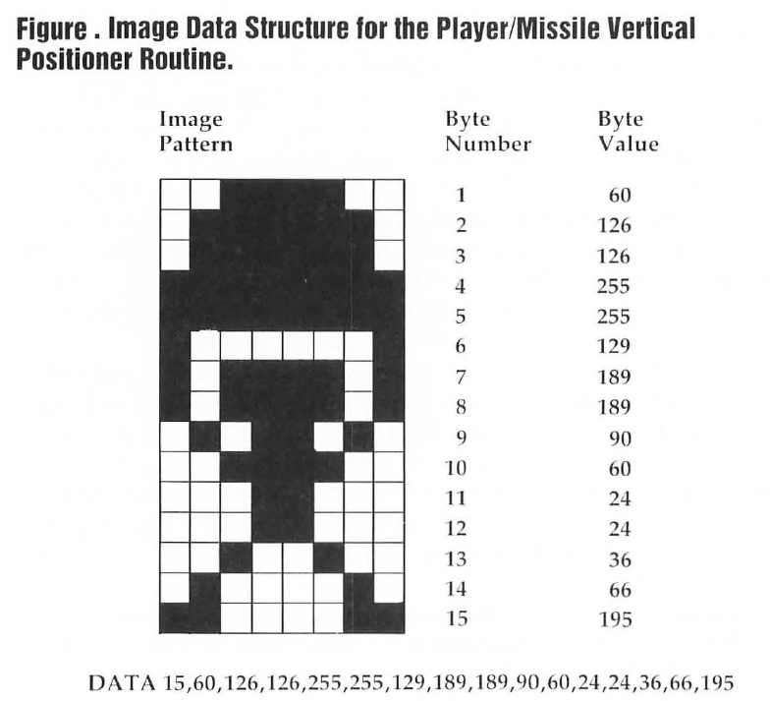
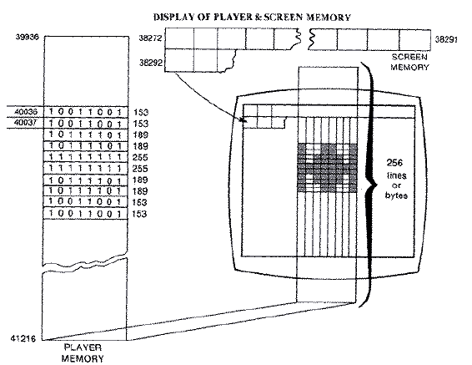
Sprites

Slide 24
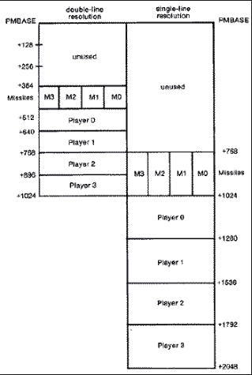
Player Missile Graphics – Hardware Sprites

Slide 25
Player Missiles Graphics
Tell ANTIC where PMBASE address is
Clear the memory of the players/missiles
Choose if you work in single line or double line resolution mode
Enable players only? Players and missiles?
What is the priority between the players and the players and the playfields
Set player colors
Set player size
Set player horizontal position
Copy the player data array into the player memory space
PMG multiplexing – change in DLI the player HPOS to have several players on screen made out of 1 player

Slide 26
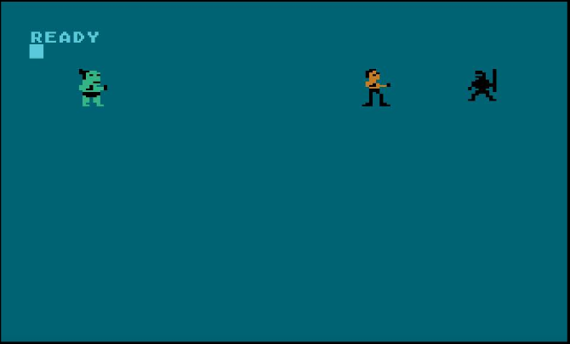
Player Missile Single Line

Slide 27
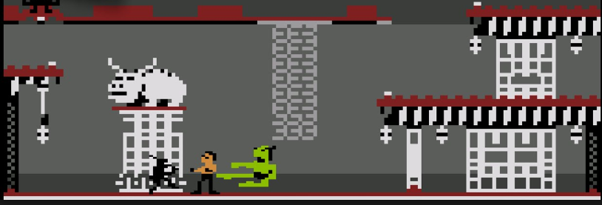
Player Missile Double Line

Slide 28
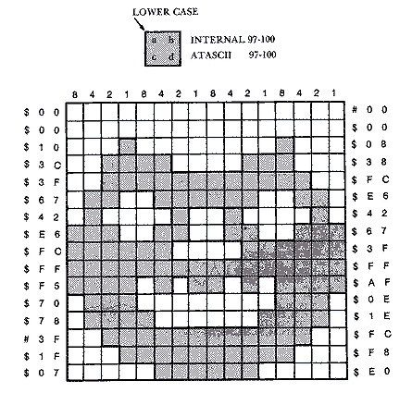
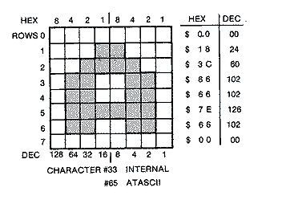
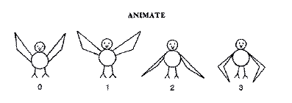
Characters Set

Slide 29
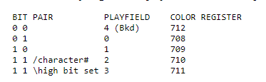
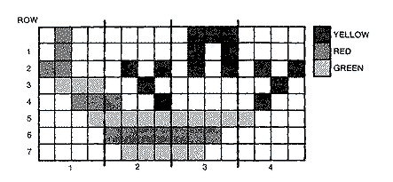
Multicolor Character Set

Slide 30
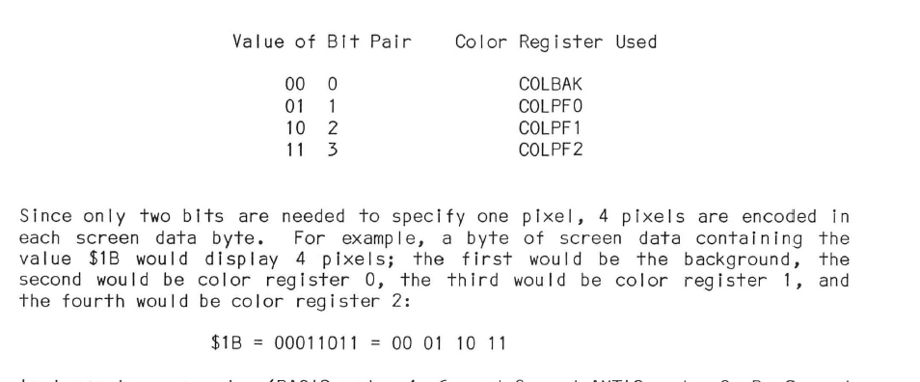
Multicolor Character Set – Continue

Slide 31
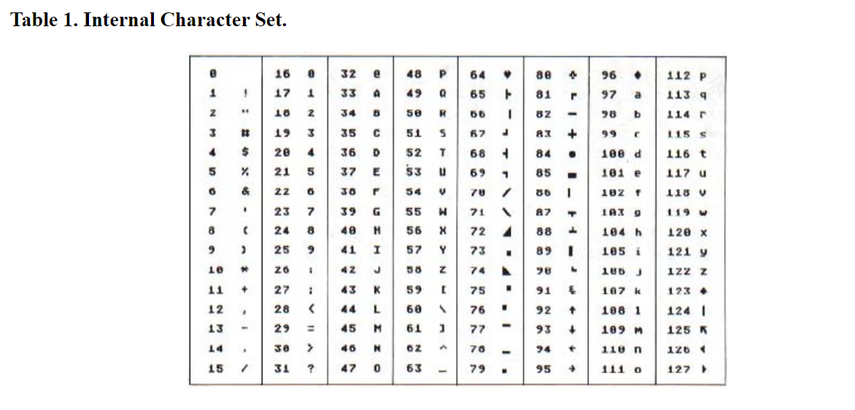
Atari ACSII - ATASCII

Slide 32
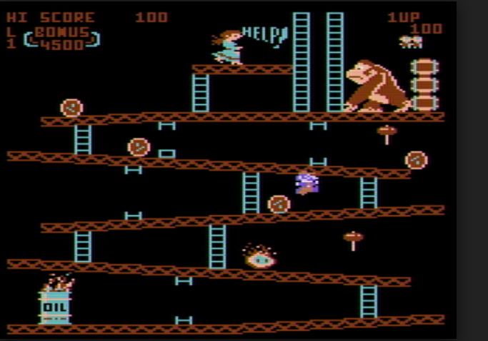
Game screen

Slide 33
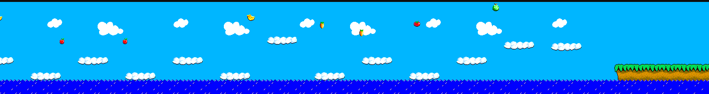
Game Screen

Slide 34
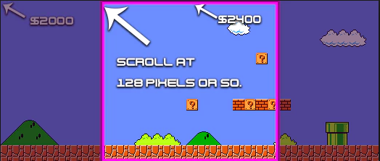
Screen Scrolling

Slide 35
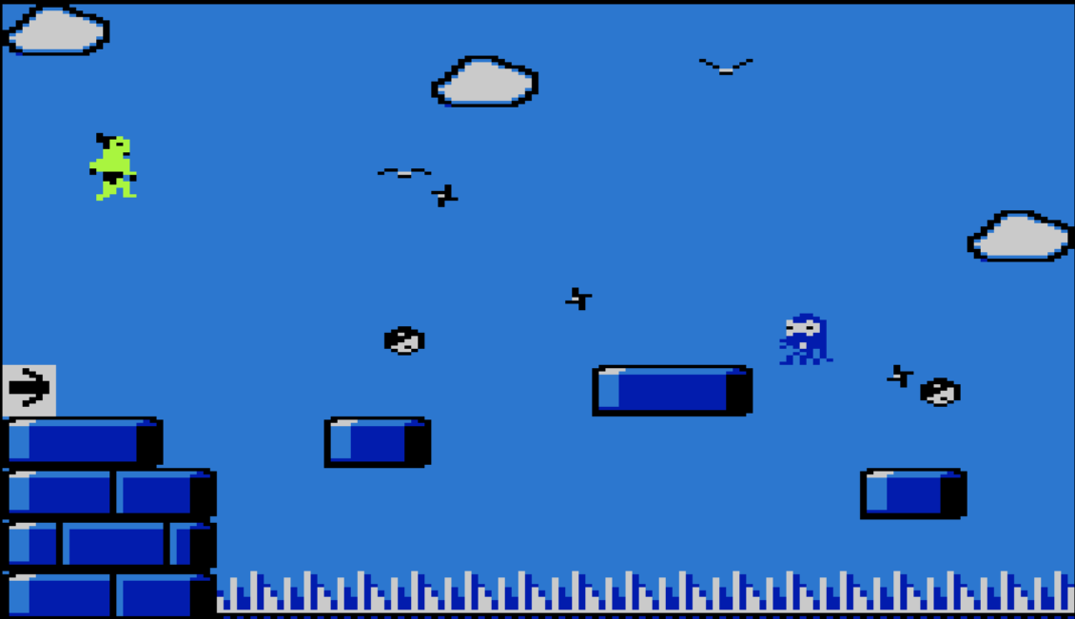
Everything happens in the main loop

Slide 36
Where do I start?

Slide 37
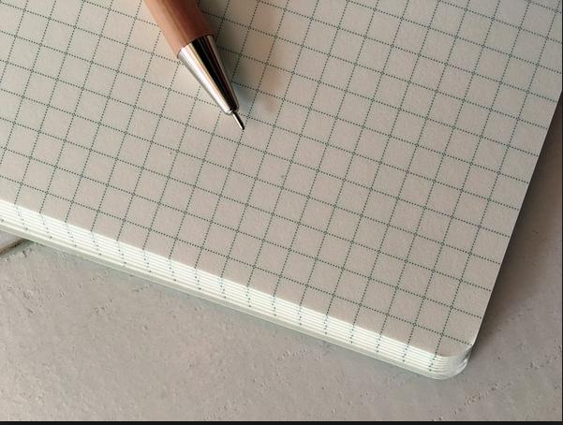
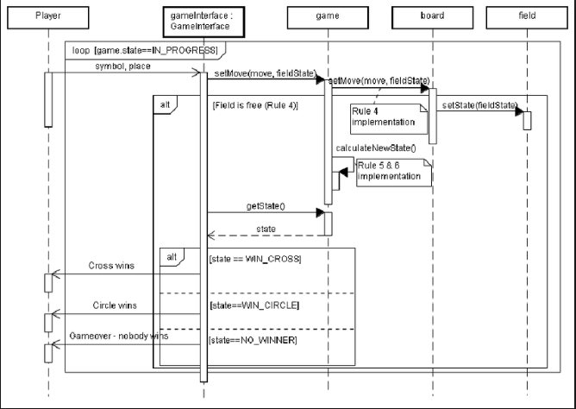
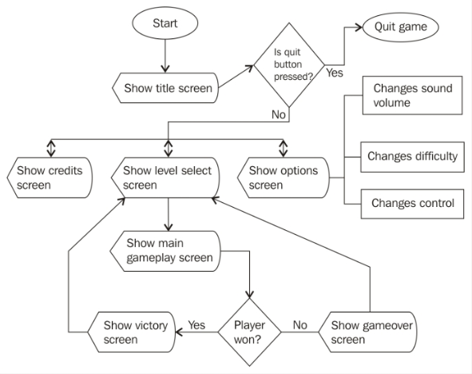

Slide 38
IDE used for development

Slide 39
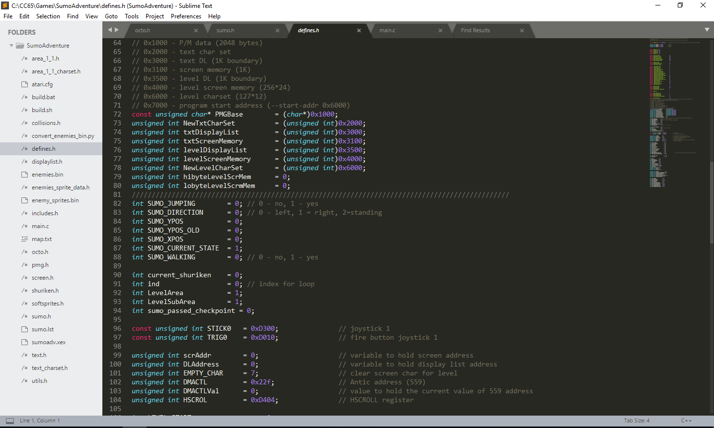

Slide 40
Emulators for Atari

Slide 41
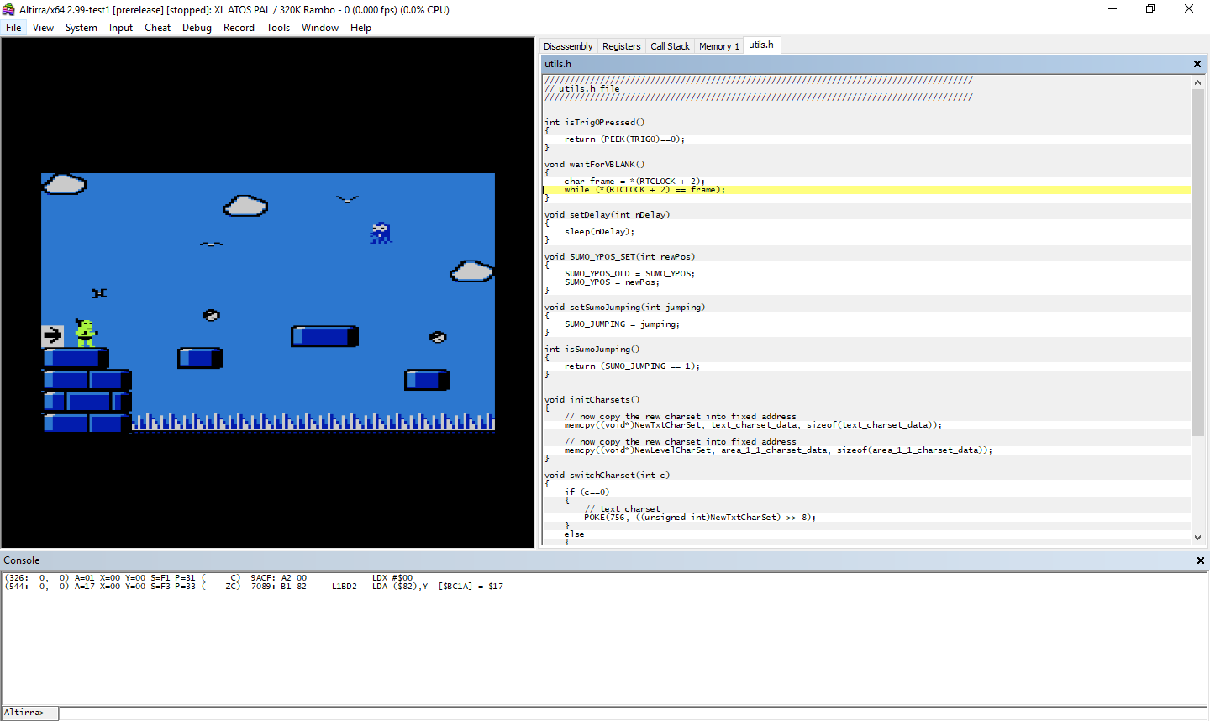

Slide 42
Tools to build custom character set

Slide 43
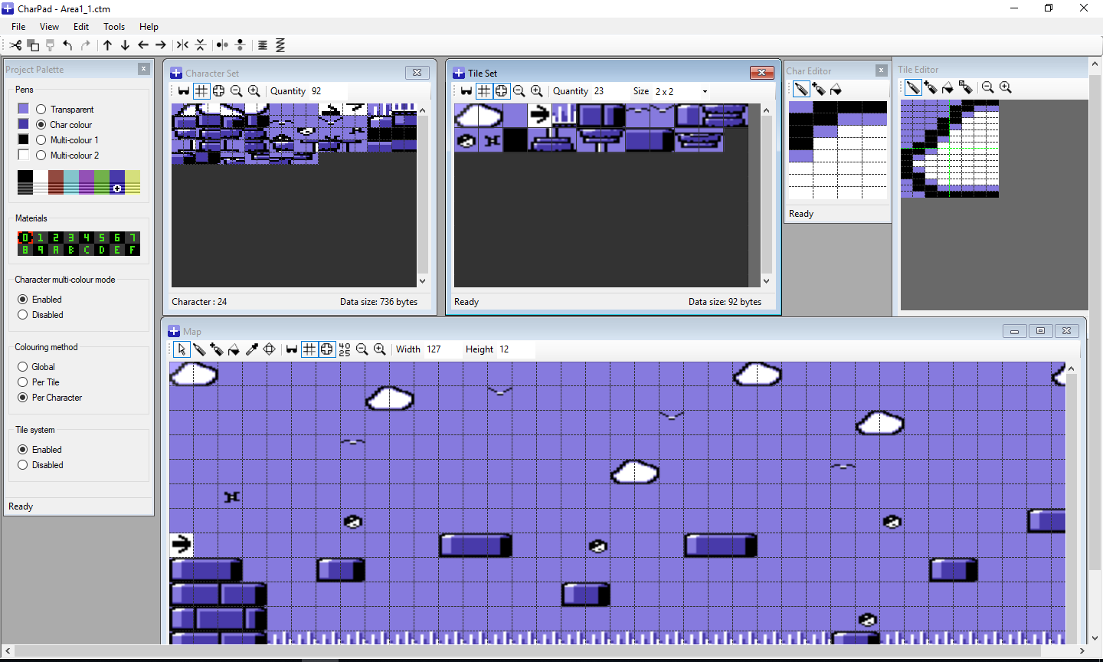

Slide 44
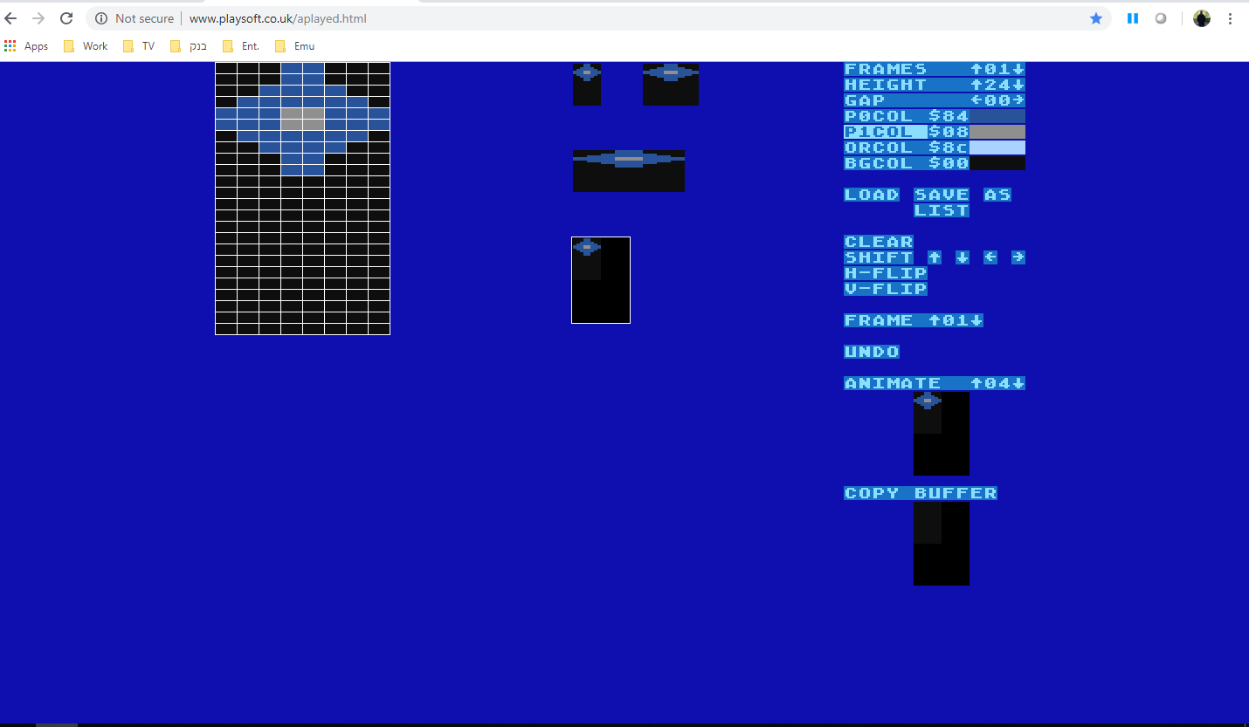
Sprite Editor http://www.playsoft.co.uk/aplayed.html

Slide 45
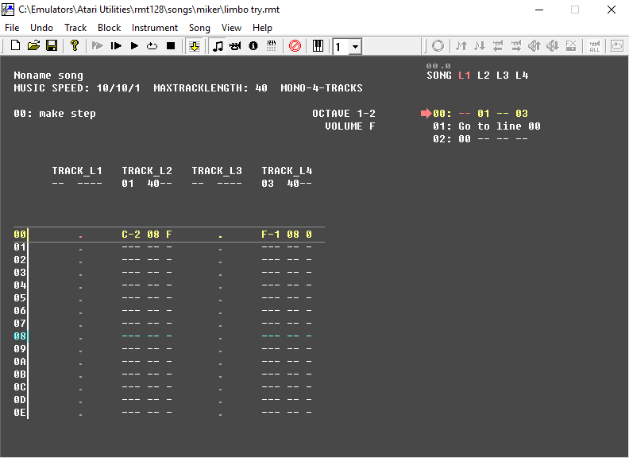
Sound Utility - RASTER Music Tracker
RMT 128

Slide 46
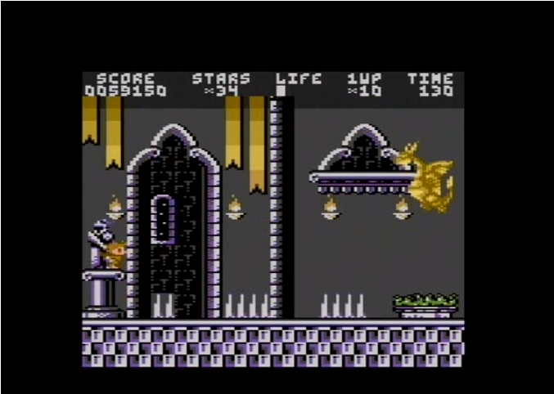
Homebrew Games
Crown Land

Slide 47
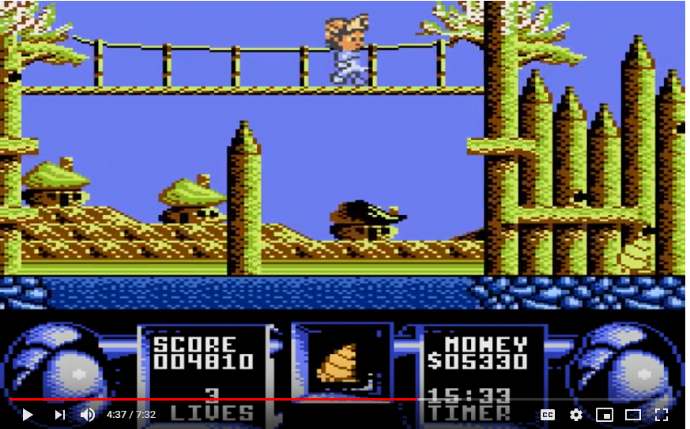
Homebrew Games
Flimbo’s Quest

Slide 48
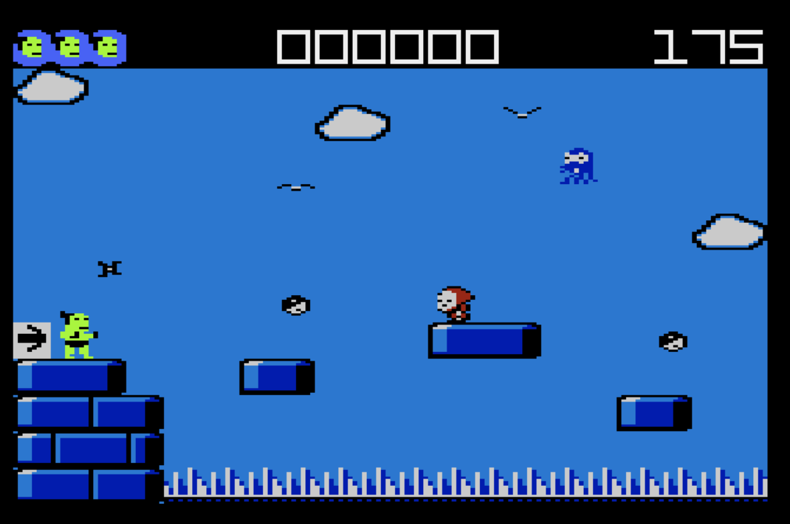
W.I.P – Sumo Adventure

Slide 49
https://www.youtube.com/watch?v=C1XJwG0FFso

Slide 50
Thank You!

